Slide 1
COMMENT TOXICITY
Deep Learning

Slide 2
TEAM MEMBERS
Abhinav Suresh(22cs002)
Abhishek Subi(22cs003)
Asma Rincy A(22cs009)
Dhana Sree V(22cs019)
Nitharshana R(22cs058)

Slide 3
Need for Comment Toxicity
Protecting Users: Identifying and filtering out toxic comments protects users from harassment, bullying, hate speech, and other forms of online abuse.
Maintaining Civility: It promotes civil discourse and constructive interactions by deterring toxic behavior and encouraging respectful communication.
Enhancing User Experience: Creating a positive online experience fosters user engagement, trust, and loyalty, leading to a vibrant and inclusive community.
Compliance: Many platforms have policies against hate speech and offensive content, making toxic comment detection crucial for regulatory compliance and platform integrity.

Slide 4
Dataframes
Find Duplicates: Identifies rows with duplicate values in the text column using duplicated and displays them.
Remove Duplicates: Drops duplicate rows, keeping the first occurrence, and updates the DataFrame in place.
Confirm Removal: Prints the new row count to verify duplicates are removed.
Reindex: Resets the DataFrame index to maintain sequential numbering.

Slide 5
Word Cloud
Visualize Toxic Content: It creates a graphical representation of the most frequent words specifically found in the text values marked as Toxic.
Identify Patterns: By emphasizing frequently used words in larger font sizes, it helps quickly spot recurring themes or vocabulary within toxic comments.
Insights at a Glance: This visualization aids in analyzing the nature of toxic language, making it easier to identify common issues or areas for intervention.

Slide 6
Synthetic Minority Oversampling Technique
Import SMOTE: SMOTE is imported from the imblearn library, which provides techniques to handle imbalanced datasets.
Initialize SMOTE: The smote object is created, which will be used to generate synthetic samples for the minority class.
Apply SMOTE: The fit_resample method:
Takes X (features) and Y (target labels) as input.
Balances the dataset by generating synthetic samples for the minority class.
Outputs X_resampled (balanced features) and y_resampled (balanced labels).

Slide 7
Binary Classification Neural Network
Dense(64, activation='relu') adds a fully connected layer with 64 neurons and ReLU activation.
Outputs a probability score (between 0 and 1) for binary classification.
Optimizer: Adam is used with a learning rate of 0.001. Adam adjusts learning rates dynamically, optimizing faster and efficiently.
Loss Function: binary_crossentropy calculates the difference between predicted probabilities and true labels, suitable for binary classification tasks.
Metrics: Tracks accuracy during training and evaluation to monitor model performance.

Slide 8
Training Data
model.fit(...): Trains the model by adjusting its weights using the training data.
Parameters:
x_train.toarray(): Converts x_train (likely a sparse matrix) into a dense array format suitable for the model.
y_train: The corresponding labels for the training data.
epochs=5: Specifies that the model will go through the entire dataset 5 times during training.
batch_size=32: Divides the training data into batches of 32 samples. The model updates its weights after each batch.
validation_split=0.2: Reserves 20% of the training data for validation to monitor the model's performance on unseen data during training.
history: Stores the training process details, including metrics (e.g., loss and accuracy) for both training and validation sets over the epochs.

Slide 9
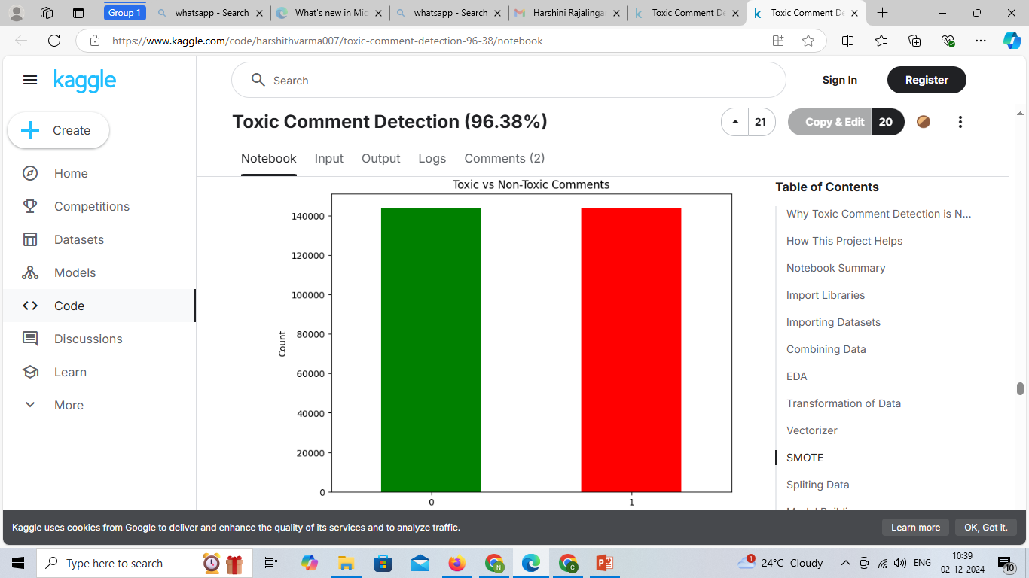
Distribution of Toxic vs Non-Toxic Comments

Slide 10
Evaluating Model Performance with Classification Metrics
Generate Predictions: Model predicts probabilities (y_pred_proba) and converts them to binary outcomes (y_pred) using a 0.5 threshold.
Create Classification Report: Computes precision, recall, and F1-score for each class using classification_report.
Convert to DataFrame: Transforms the report into a DataFrame for easier visualization.
Filter Metrics: Excludes overall metrics (e.g., accuracy) to focus on individual class performance.
Visualize with Heatmap: Plots a color-coded Seaborn heatmap of precision, recall, and F1-score for each class.
Purpose: Quickly assess model strengths, weaknesses, and areas for improvement.

